Slide 1
PAST CONTINUOUS
Caterina Ines Latella

Slide 2
index
Definition, contex and timeline
Form: affirmative, negative and interrogative (plus short answers)
Past continuous versus past simple
While/when/during/as
Practice
Weblinks

Slide 3
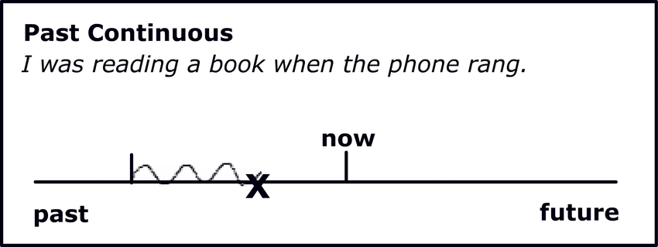
PAST CONTINUOUS: was/were+ V-ing
The past continuous shows us that the action was already in progress at a certain time in the past.
We make the past continuous with was or were and the -ing form of the verb.
The past continuous can also show that an activity was in progress for some time, not just for a moment.
We were cleaning the house all morning/during lunch time.

Slide 4
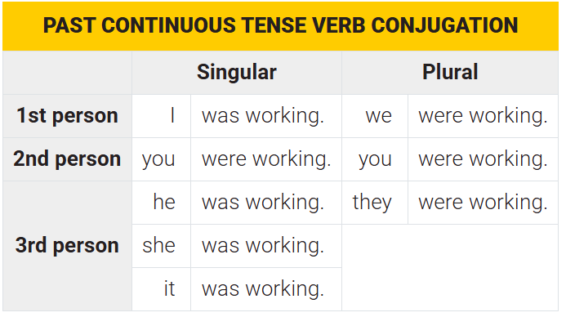
form
AFFIRMATIVE: I was studying/They were sending a text.
NEGATIVE: Mark and I weren’t studying
INTERROGATIVE: What were you doing at 8 p.m. last night?
Were you studying last night at 20:00?
SHORT ANSWERS: Yes, I was . No, I wasn’t.

Slide 5
What were you doing yesterday at 7:00 pm?
At 7 o’clock last night, I was…
At 7 o’clock last night, Mark and Ann were…
…cooking dinner
…eating dinner
…reading a book
…watching a TV series
…speaking on the phone
…studying
…working
…driving home

Slide 6
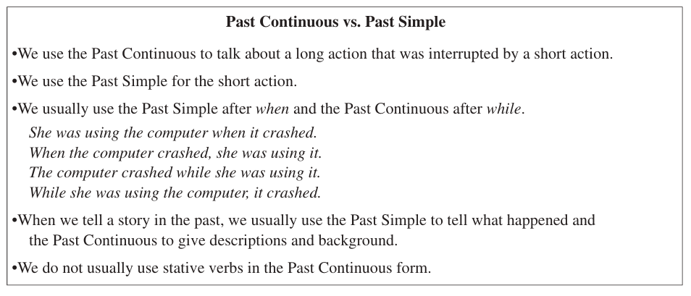
PAST CONTINUOUS VS PAST SIMPLE

Slide 7
PAST CONTINUOUS VS PAST SIMPLE
We often use these tenses to show an action interrupting another action.
I broke my leg while I was skiing.
As I was going to work, I saw an old friend.
We were watching television when the power went off.
Can you see a difference in the meaning of these two sentences below?
When the guests arrived, Jane was cooking dinner.
When the guests arrived, Jane cooked dinner.

Slide 8
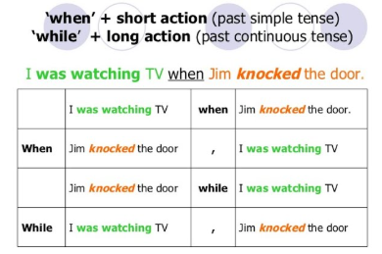
WHEN/WHILE

Slide 9
WHILE + past continuous
While the technicians were repairing my computer, Mark and I were preparing the invoice.
WHEN + past simple
When technicians she arrived, Mark and I were preparing the invoice.
AS + past continuous(simultaneous background action=while)
As I was revising the presentation, the light went off
DURING + period of time/noun
During his lunch hour, Tim was buying a new camera at the department store.

Slide 10
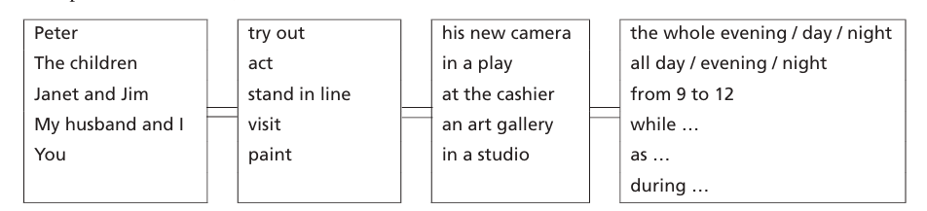
What were THESE PEOPLE doing yesterday?

Slide 11
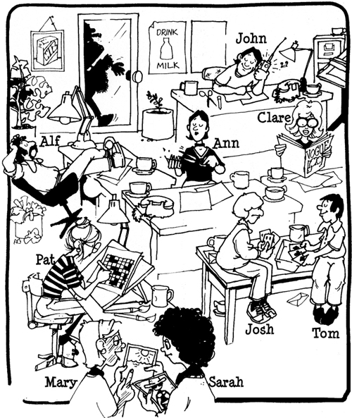
What was happening yesterday at 17:00?
Ex: Alf wasn’t working, he was sleeping
- Work/sleep
- Talk on the phone /listen to the radio
- Send letters/play cards
- Write a report/ do a crossword
- Send emails/Cut her nails
- Classify documents/ look at photos
- Phone customers /read a magazine

Slide 12
Weblinks
https://www.baamboozle.com/game/138648
https://learnenglish.britishcouncil.org/grammar/a1-a2-grammar/past-continuous-past-simple
https://test-english.com/grammar-points/a2/past-continuous-past-simple/
BURLINGTON
chrome-extension://efaidnbmnnnibpcajpcglclefindmkaj/https://cdn.burlingtonenglish.com/cache/worksheets/13/136302_f74bb66a9938dde2ee8c430ad24094a3.pdf
chrome-extension://efaidnbmnnnibpcajpcglclefindmkaj/https://cdn.burlingtonenglish.com/cache/worksheets/13/136303_a11a0df87db64aa0a8f2b0bb25c13d2b.pdf

Slide 13

Thank you
Caterina Ines Latella

